Slide 1





Project: Home Irrigation Control System (HICS) Team: SmartGrass
CSE Senior Design I
Architecture Design Specification
CSE 4316 Final Exam
Belachew
Haile-Mariam(L)
Gautam
Adhikari
Jeremiah
O’Connor
Tung
Vo
Notes:
This presentation demonstrates the new capabilities of PowerPoint and it is best viewed in Slide Show. These slides are designed to give you great ideas for the presentations you’ll create in PowerPoint 2010!
For more sample templates, click the File tab, and then on the New tab, click Sample Templates.

Slide 2
GUIDING PRINCIPLES
1

Slide 3
Guiding Principles
Scalability
Users can add or remove valves or sensors
Hardware expansion elements can be changed

Slide 4
Guiding Principles
Ease of Use
HICS can be accessible to users of most of ages and most of technical backgrounds
Web application interface must be intuitive and user-friendly
Simple steps to control the irrigation system

Slide 5
Guiding Principles
Maintainability
HICS will require minimal maintenance after purchase
All sensors should be replaceable and re-installed at the user level
Plug and play type central control unit will be built to interface for all sensors

Slide 6
Guiding Principles
Compatibility
HICS will work with most of the existing sprinkler system
Central control unit should be built to connect directly with valve wires

Slide 7
LAYER DEFINITIONS
2

Slide 8
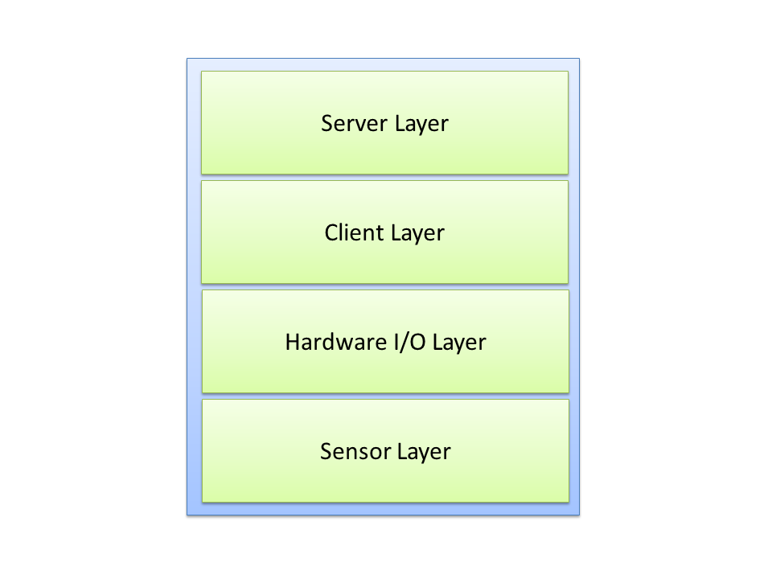
Layer Structure Overview

Slide 9
Sensor Layer
Purpose
Gathering data from the sensors to monitor different environment conditions
Providing service(s):
Sending all the different environment condition readings to the Hardware I/O Layer.
Expecting service(s):
Including 3 kinds of sensor, electronic components, not expecting any service from other layers

Slide 10
Hardware I/O Layer
Purpose
Collecting information from the environment sensors
Controlling the activities of the irrigation valves
Providing service(s):
Taking input data from sensors
Differentiating the input
Formatting the data to be sent to Client layer
Expecting service(s):
Sensor reading as input data from Sensor Layer
Control command data from Data processing at Client Layer

Slide 11
Client Layer
Purpose
Handling the communication between Hardware I/O Layer and Server Layer
Providing service(s):
Taking sensor input from Hardware I/O Layer and sending it to Server Layer.
Receiving response from Server Layer and sending it to Hardware I/O Layer.
Expecting service(s):
Sensor input form Hardware I/O Layer
Data response from Server Layer

Slide 12
Server Layer
Purpose
Handling the interfacing with the users
Processing the requests from Client Layer
Updating information to Database
Providing service(s):
Handling request and sending response to Client Layer.
Expecting service(s):
Requests from Client Layer

Slide 13
SUBSYSTEM DEFINITIONS
3

Slide 14
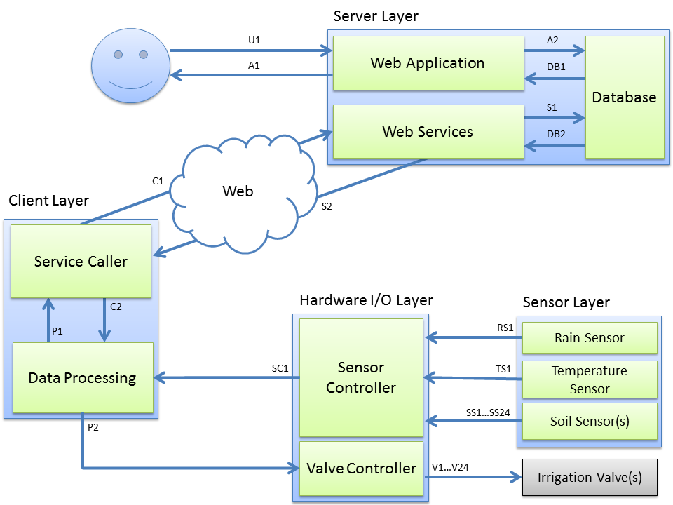
Subsystem Data Flow Diagram

Slide 15
Sensor Layer Subsystems
Rain Sensor: Detect precipitation amounts by collecting rainfall to alert the rain condition
Temperature Sensor: Measure the current temperature of the environment
Soil Moisture Sensor: Measure the current soil moisture sensor at its corresponding irrigation zone.

Slide 16
Subsystem Data Flow Diagram

Slide 17
Hardware I/O Layer Subsystems
Sensor Controller:
Interface directly to all sensors, read the signal transmitted from the sensors
Sending the sensor input to Data Processing subsystem
Valve Controller:
Interface directly to irrigation valves
Receive control command from Data Processing subsystem to turn the valves on or off

Slide 18
Subsystem Data Flow Diagram

Slide 19
Client Layer Subsystems
Service Caller:
Taking information from the Data Processing subsystem and sending it to the Web Service at Server Layer
Receiving response form the Web Service and sending it back to Data Processing subsystem
Data Processing:
Parsing sensor data form Sensor Controller, processing, passing this data to Service Caller
Parsing data form Server Caller, formatting it and relaying it to the Valve Controller

Slide 20
Subsystem Data Flow Diagram

Slide 21
Server Layer Subsystems
Web Application: Providing GUI to users, presenting information and accepting input from users
Database: A central hub for data communication between the server and client layers
Web Services: A communication link between the client systems and the database.

Slide 22
INTER-SUBSYSTEM DATA FLOW
4

Slide 23
Subsystem Data Flow Diagram

Slide 24
Data Flow Descriptions
Data Element ID | Description | Source | Sink
U1 | User enters input into the web application or interacts with the applications GUI. | User or Admin | Web Application
A1 | User requested data is presented through the application GUI on the user’s web or mobile browser. | Web Application | User or Admin’s web or mobile browser.
A2 | Data is received from the user to either update or request information about their system. | Web Application | Database
DB1 | Requested data from the web application query is located and returned. | Database | Web Application
DB2 | Requested data from the web service query is located and returned. | Database | Web Services

Slide 25
Data Flow Descriptions
Data Element ID | Description | Source | Sink
S1 | The data requested from the client is queried or data is sent to the database for storing. | Web Services | Database
S2 | The service caller receives a response from a web service with requested information or a response status code. | Web Services | Service Caller
C1 | A request sent to the web service for either a valve switch command (on/off), data update response, or the caller sends new sensor readings for storage. | Service Caller | Web Services
C2 | Data returned by the web service is relayed to the data processor to check for valve switch commands to turn the water valves on or off. | Service Caller | Data Processing

Slide 26
Data Flow Descriptions
Data Element ID | Description | Source | Sink
P1 | Data from the sensors is processed and formatted then passed to the service caller. | Data Processing | Service Caller
P2 | Response data from the service caller is processed and an operation command is sent to the valve controller. | Data Processing | Valve Controller
SC1 | Parsed data from the sensors is sent to the data processing subsystem. | Sensor Controller | Data Processing
IV1+ | Control signals are parsed and sent to the irrigation valves to turn them on or off. | Valve Controller | Irrigation Valve(s)
RS1 | An alert signal is sent from the rain sensor if a specified amount of rain has been detected. | Rain Sensor | Sensor Controller
TS1 | A temperature reading from the temperature sensor is sent to the sensor controller for parsing. | Temperature Sensor | Sensor Controller
SS1+ | Soil moisture readings are sent from the soil sensors to the sensor controller for parsing. | Soil Sensor(s) | Sensor Controller

Slide 27
Subsystem Data Flow Diagram

Slide 28
QUESTION?
?

